Slide 1


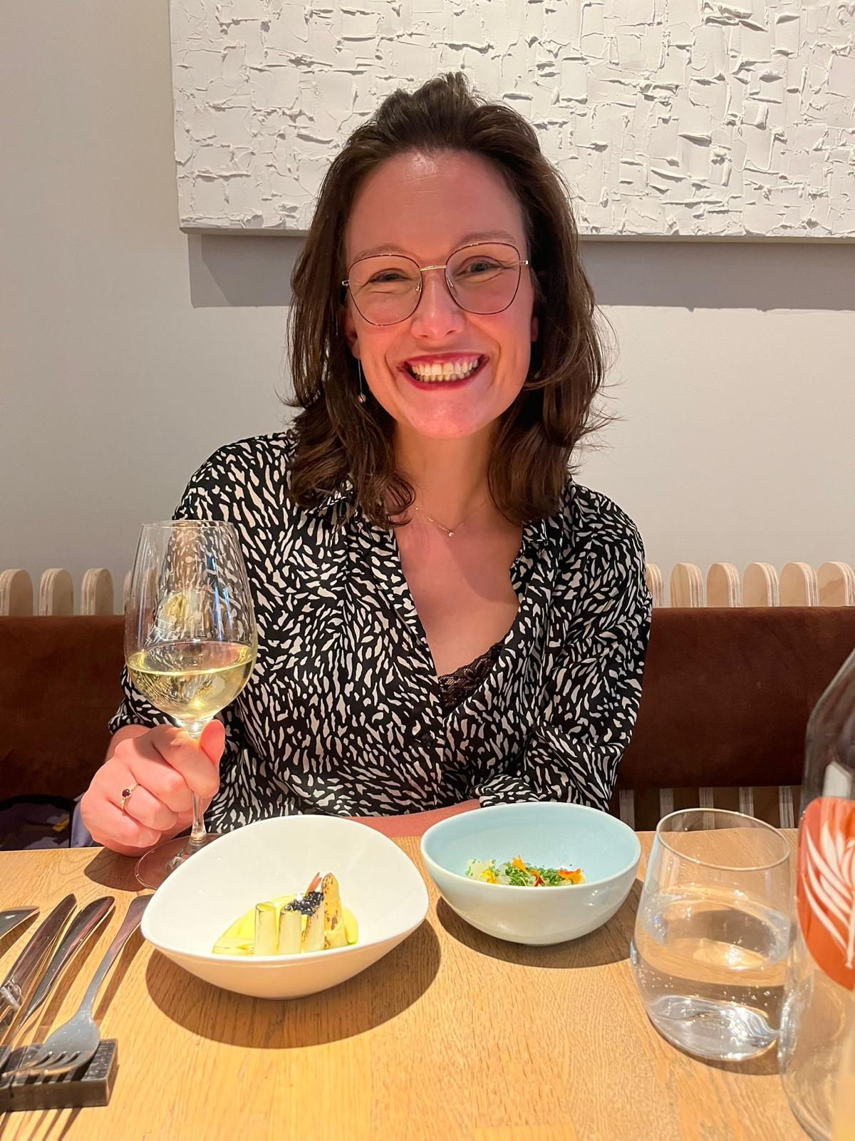
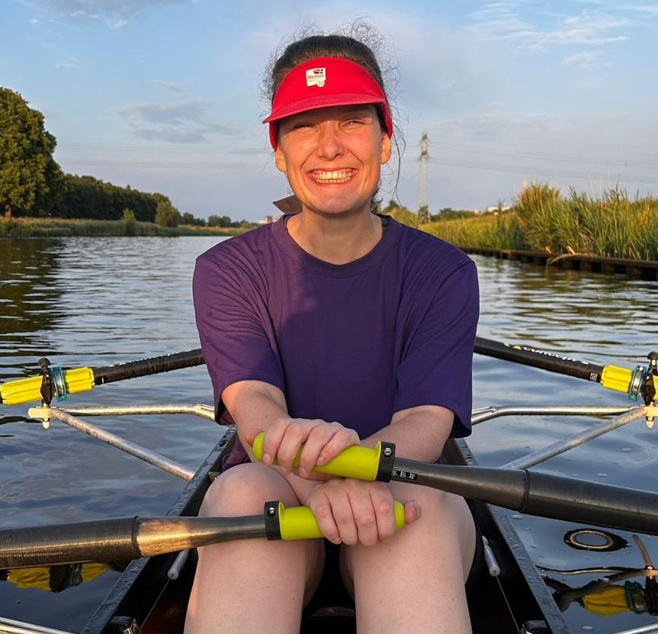
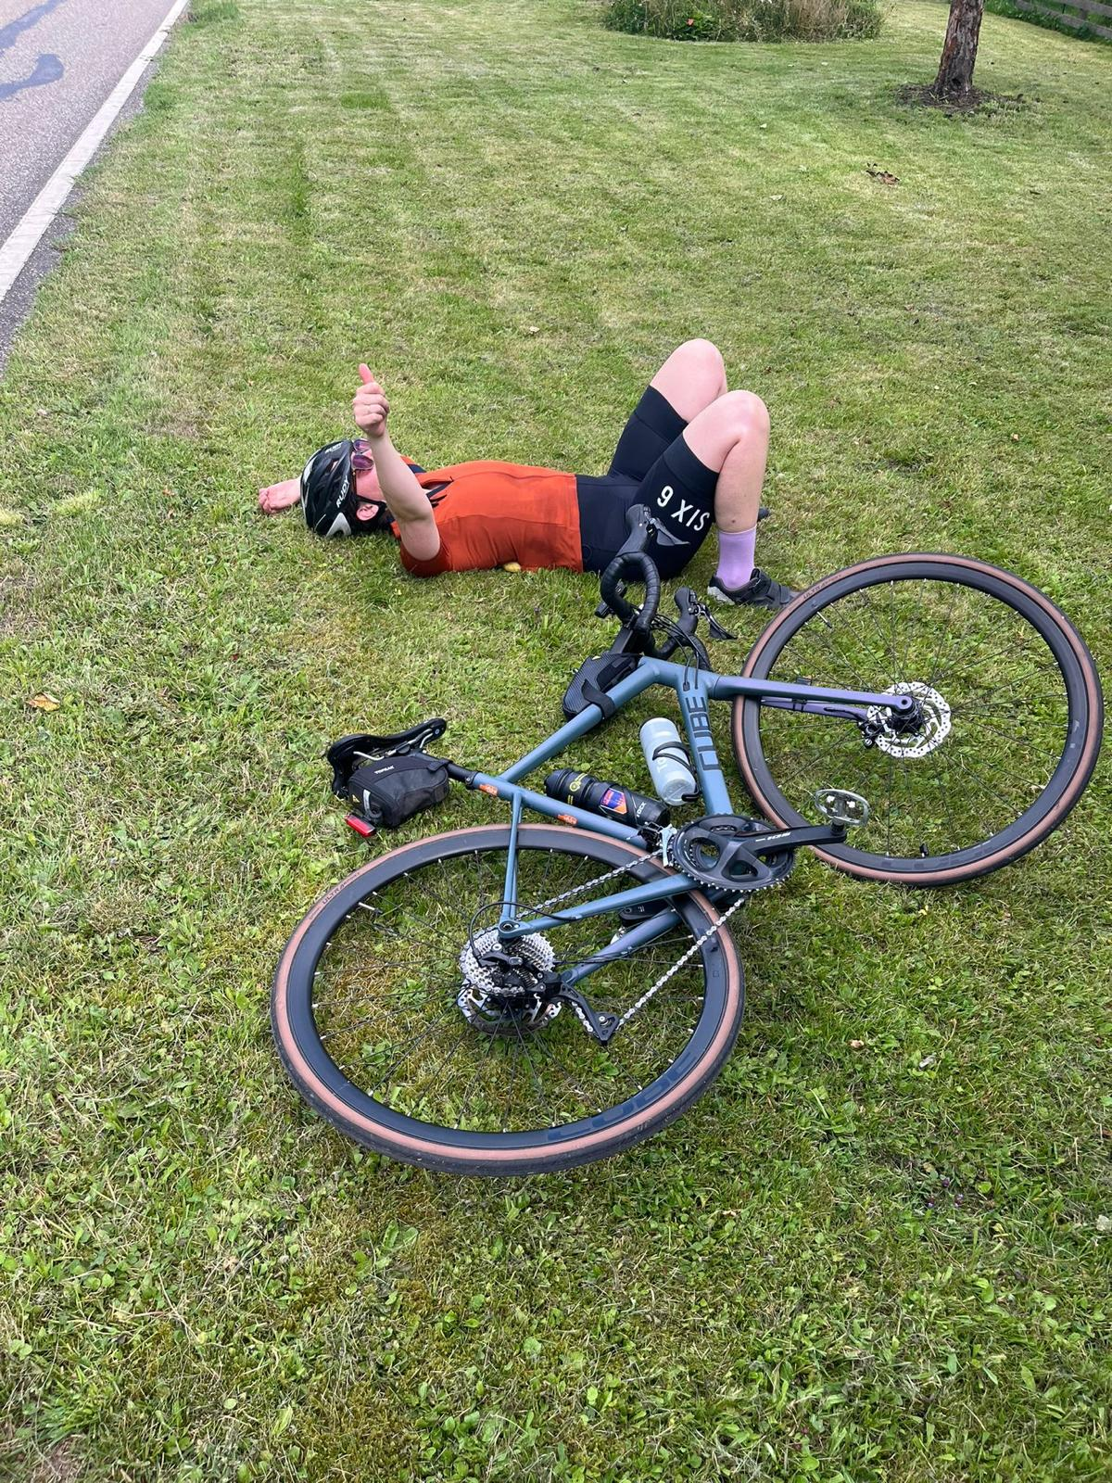
Getting to Know Me
Work
Personal
My role
Nutrition and Health Manager
Significant others / family members / furry friends in my life
My husband Joris and our two cats Pien and Herman!
Tenure in ofi/Olam
1,5 years
How I enjoy spending my free time
Cycling, rowing, photography, time with friends
Previous companies I have worked at
Global Alliance for Improved Nutrition
My favorite / comfort food
Gyoza and pho
Why I joined ofi/Olam and what keeps me here?
Making a direct impact on wellbeing in farming communities globally.
My favorite song
Can’t take my eyes off you – Frankie Valli
Mirjam
Kneepkens
Mirjam
A few fun facts about me
I started this role in the Amsterdam office, but I now live in Kumasi for a year. I love it!
I love anything creative, and I try to bring that creativity into my work.
This is me outside work, doing stuff I enjoy in my life …

